Slide 1



SMART INDIA HACKATHON 2025
Edge-AI Drone for Proactive Stampede Prevention
Real-Time Stampede Detection and Crowd Analysis System
Problem Statement ID – SIH25118
Problem Statement Title- Student Innovation
Theme- Smart Automation
PS Category- Hardware
Team ID- 52880
Team Name- FALCON
Edge-AI Drone for Proactive Stampede Prevention | Team FALCON

Slide 2
The Problem & The Gap
The Critical Issue: Large gatherings (religious events - Kumbh Mela) are prone to deadly stampedes due to delayed response time.
Why Current Solutions Fail:
CCTV: Fixed angles, blind spots, and reactive (only records what happened)
Network Collapse: In large gatherings (e.g., concerts, pilgrimages), cellular networks (4G/5G) become saturated.
The Cloud Risk: Systems relying on off-loading data to a server fail when bandwidth drops.
Operational Disconnect (The Human Gap): Relying on manual monitoring creates a fatal response lag caused by cognitive fatigue and the slow relay of critical information to ground team
Manual Drones: Rely on human pilot vigilance; fatigue leads to missed signs and limited flight Duration.
Edge-AI Drone for Proactive Stampede Prevention | Team FALCON

Slide 3
System Overview (The Prototype)
Proposed Solution: An AI-driven Autonomous Drone that monitors crowds in real time using a Jetson Nano On board and triggers instant alerts to prevent stampede risks.
Key Capabilities & Novelty:
Autonomous Drone Surveillance
Integration of AI-powered On board edge computing on drone
No cloud dependency
Rapid Alert Mechanism with Early Prediction Capability
Visual analysis for day/night operation (Raspberry Pi NoIR Camera)
Panic Motion Detection Identifying sudden, erratic velocity changes (running/scattering)
Real Alerts Instantly sending GPS coordinates of the risk zone to ground authorities
Edge-AI Drone for Proactive Stampede Prevention | Team FALCON

Slide 4
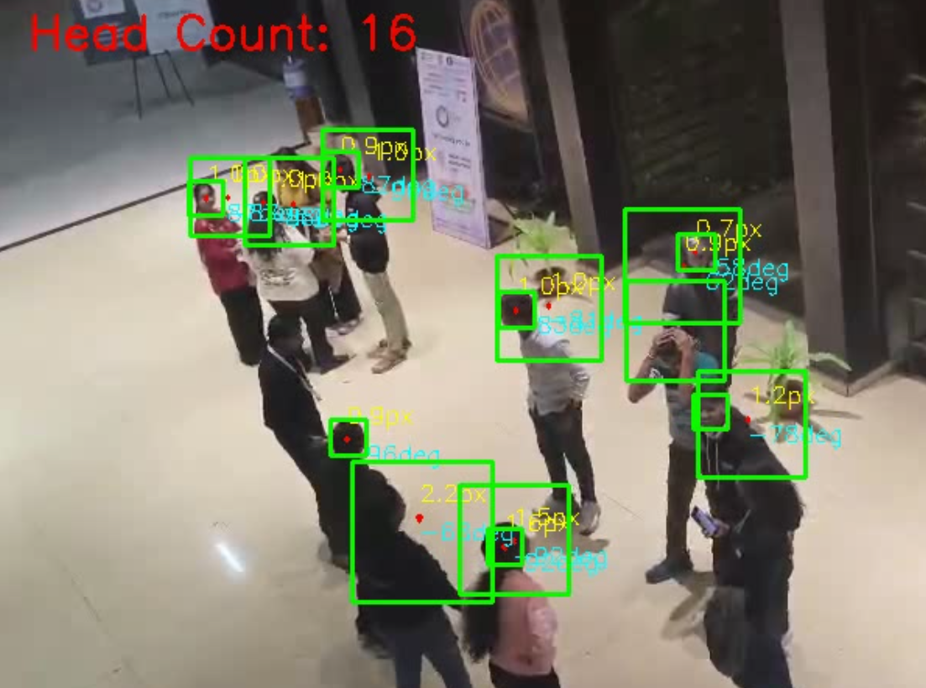
AI & Software Pipeline (The "Brain")
Stampede Detection – Key Components
• Input: 1080p frames resized to 640×360 for real-time processing • Dataset Used: ShanghaiTech Crowd Dataset (head-level annotations)
Models Used
• YOLOv8n (Trained): Custom-trained for head detection on ShanghaiTech • YOLOv8n (Pretrained): Uses Weights of yolo model to detect person • Combined using Cross-Model NMS (IOU 0.45)
Core Algorithm Elements: Grid-based partitioning of frame Density counting per grid cell Optical flow for motion direction + speed (farneback’s Denseflow optical Model)
Demo
Edge-AI Drone for Proactive Stampede Prevention | Team FALCON

Slide 5
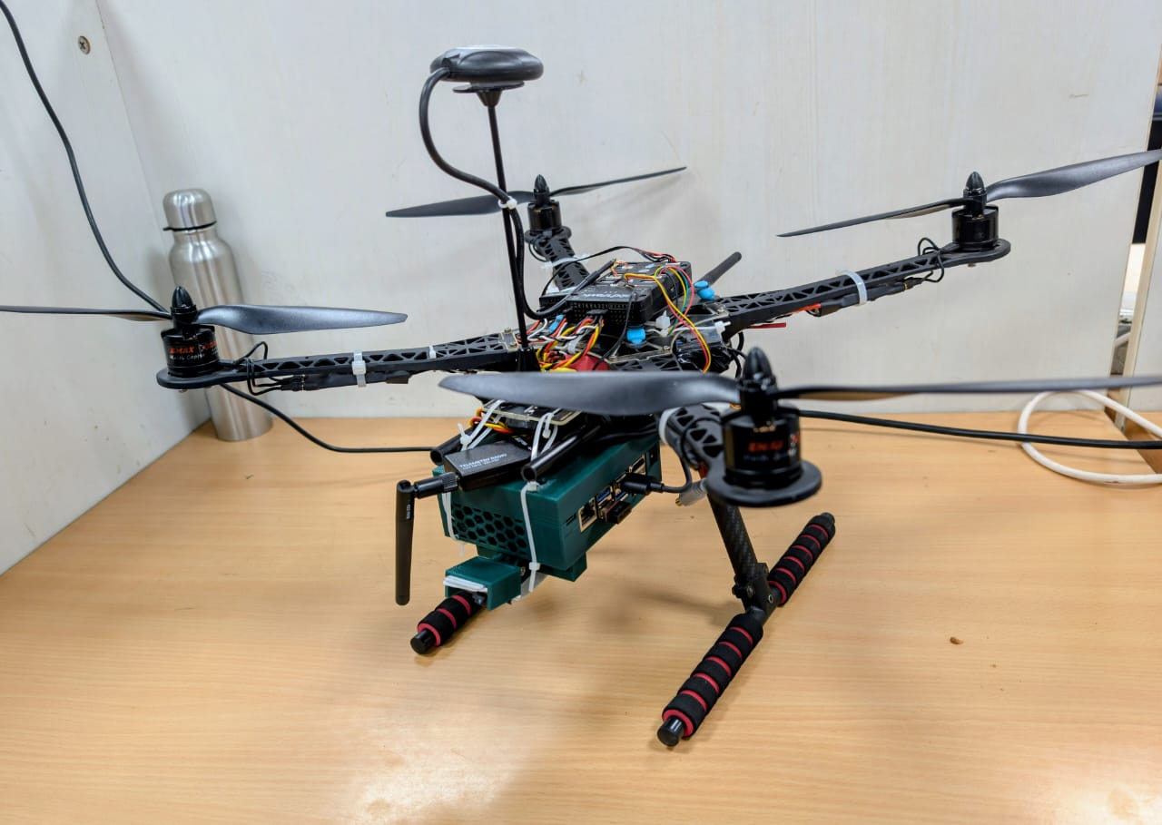
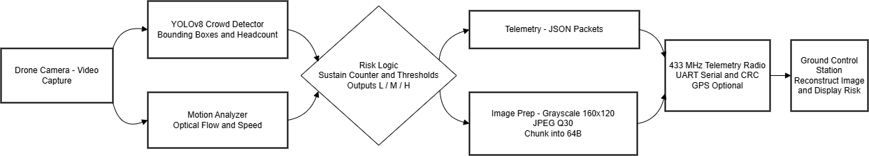
Hardware Architecture (The Body)
Flight Platform: Custom-assembled Quadcopter.
Compute Unit: NVIDIA Jetson Nano (4GB) – The Edge Brain.
Vision Sensor: Raspberry Pi Camera Module V2 (CSI Interface).
Flight Controller:
Pixhawk 2.4.8 (Standard open-source controller).
Dedicated Power Supply 1.Drone flight 2. Jetson Nano with 5V-4A Power output.
Edge-AI Drone for Proactive Stampede Prevention | Team FALCON

Slide 6
Stampede Risk Calculation
Communication Module
Combines headcount, motion, entropy, density to estimate risk Simple rule-based engine:
High count + high motion → HIGH RISK
High count only → MEDIUM RISK
Small crowd or calm movement → LOW RISK
Can be replaced by AI model later.
Radio Telemetry
100 mW 433 Mhz .
Operates in ISM bands like, 868 MHz, 915 MHz, 2.4 GHz.
Transmission is short-range and low duty-cycle.
Performs highly reliably even when tens of thousands of people are present.
Edge-AI Drone for Proactive Stampede Prevention | Team FALCON

Slide 7
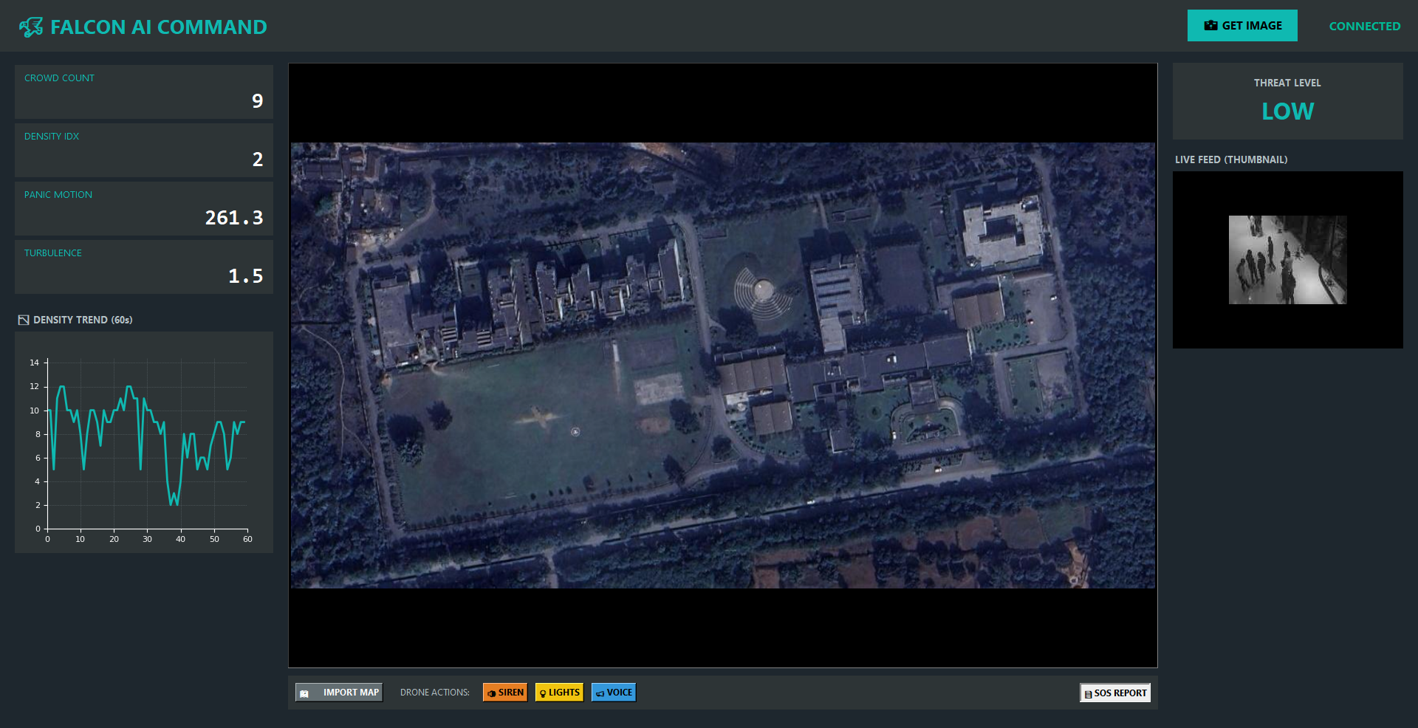
Dashboard (The "Interface")
Falcon_dashboard.py
Edge-AI Drone for Proactive Stampede Prevention | Team FALCON

Slide 8
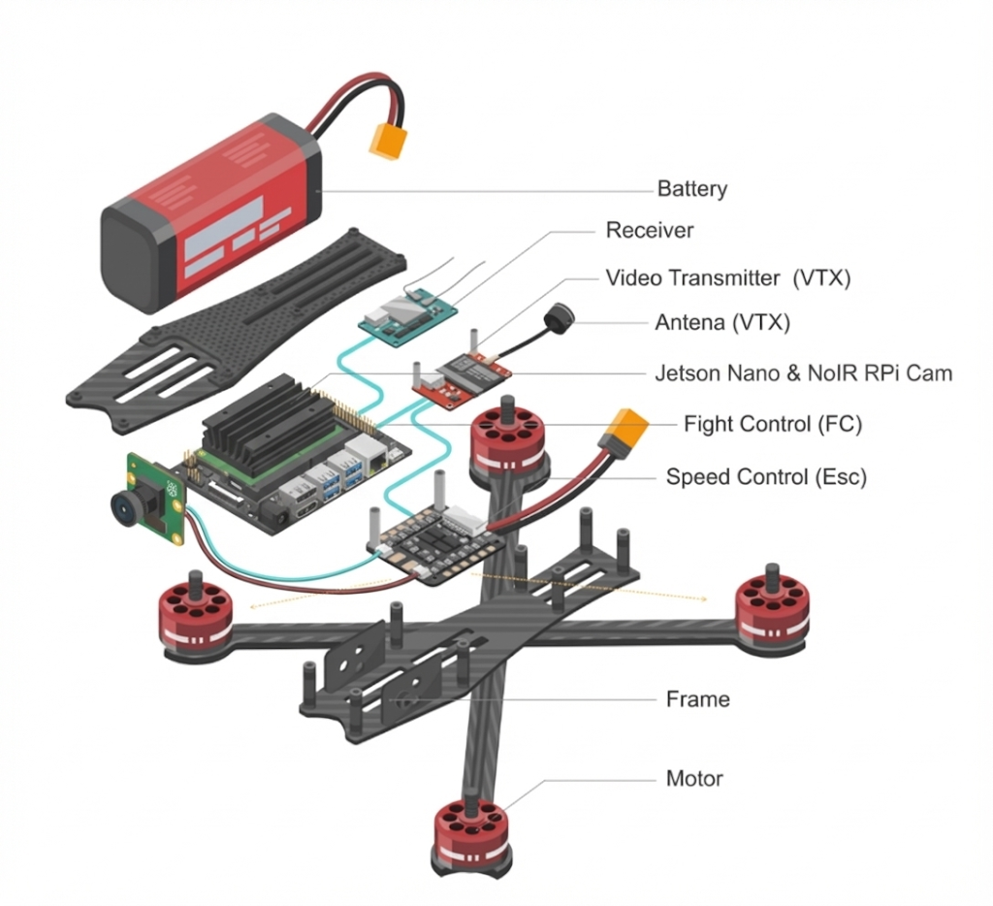
Autonomous Aerial Platform
1. Drone Configuration
Propulsion: 2212 920KV Motors | 30A ESCs | 2:1 Thrust/Weight Ratio
Avionics: Pixhawk 2.4.8 with Redundant IMU/GPS.
Payload: 1.2kg AUW (Includes Jetson Nano + Battery).
2. Optics & Coverage (at 5m Altitude)
Sensor: Raspberry Pi NoIR Camera (Night-Vision Enabled).
Footprint: 6.05 m × 4.55 m = 27.53 m²
3. Crowd Density Thresholds (27.5 m²)
Normal: < 55 heads (Safe).
Warning: 55 – 110 heads (Monitor).
CRITICAL: > 110 heads Auto-Alert Trigger.
Edge-AI Drone for Proactive Stampede Prevention | Team FALCON

Slide 9
Power Management & Safety Architecture
1. Dual-Rail Power Architecture
Physically Isolated Power Rails.
Primary Loop (Propulsion): Direct high-current line to ESCs/Motors.
Secondary Loop(Compute): Separate battery (7.4V) + XL4015 DC-DC Buck Converter Module (4A/5V)for the Jetson Nano.
2. Battery & Endurance Profile
Source: 3S 6800mAh LiPo (40C High-Discharge).
Endurance: ~18-22 Minutes continuous flight time with full AI load (10W).
Payload Optimization: System tuned for 1.7kg AUW (All-Up Weight) with a 2:1 thrust-to-weight ratio.
3. Active Safety Failsafes
Voltage Monitoring: Auto-RTL (Return-to-Launch) triggers if voltage drops below 10V (3.7V/cell).
Edge-AI Drone for Proactive Stampede Prevention | Team FALCON

Slide 10
Business Viability & USP
Business Viability & USP
Cost-Effectiveness: One drone (72,000 deployment) covers the area of 50 fixed CCTVs (10,00,000 cabling + operator + server cost).
Scalability: Swarm-ready. Multiple drones can divide a large area into grids.
Dual Utility: When not preventing stampedes, the same hardware can be used for lost child finding or general surveillance.
Practical – Provides early warnings, enabling authorities to act before a stampede occurs.
Edge-AI Drone for Proactive Stampede Prevention | Team FALCON

Slide 11
Conclusion & Future Scope
Future Scope:
Integration of Thermal Cameras for night-time crowd monitoring
Audio-based panic detection (screams) using onboard microphones.
Swarm Drone
Major Achievements :
1st prize in Kumbh Hackathon Organized by IEEE IIC VPKBIET, Baramati, Pune
Collaborated with K. K. Wagh Institute, Nashik to provide solutions for the upcoming Kumbh 2026-27
Ultimately
FALCON is not just a drone; it is a proactive life-saving system that acts before a tragedy occurs.
Edge-AI Drone for Proactive Stampede Prevention | Team FALCON

